Slide 1


FLIPKART TELEVISION ANALYSIS USING WEBSCRAPING

Slide 2
About Us:
Background? (B-tech)
Why you want to learn Data Analytics
Any work experience
Share your LinkedIn and GitHub profile URLs
LinkedIn : https://www.linkedin.com/in/sridurgathogiti
Github : https://github.com/durga-4h6

Slide 3
Preface:
INTRODUCTION
BUSINESS PROBLEM
OBJECTIVE
TOOLS USED
WEB SCRAPPING
DATA CLEANING STEPS
DATA VISUALIZATION
CONCLUSION

Slide 4

Introduction
Flipkart is one of India’s leading e-commerce platforms, offering a wide variety of televisions across different brands and price ranges.
The project focuses on web scraping television data from Flipkart using Python and BeautifulSoup.
The collected dataset includes key details such as brand, screen size, display type, ratings, reviews, resolution, and prices.
The objective is to analyze pricing patterns, popular TV brands, feature preferences, and customer ratings using Pandas and Matplotlib.
Insights from this analysis help understand consumer demand, compare television features, and support data-driven decisions for customers and businesses.

Slide 5

Business Problem
Product information related to televisions on e-commerce platforms like Flipkart is vast and unstructured, making systematic analysis challenging.
Customers often find it difficult to compare televisions across brands based on price, screen size, resolution, features, and customer ratings.
Retailers and manufacturers lack clear insights into market trends such as popular TV sizes, preferred display technologies, and price-sensitive segments.
There is a strong need for data-driven analysis using web scraping to identify top-performing television brands, optimal pricing ranges, and customer sentiment patterns from ratings and reviews.

Slide 6
Objectives
To analyze and compare television brands available on Flipkart based on key product attributes such as price, screen size, resolution, and customer ratings.
To identify pricing patterns and performance trends across different television brands and display technologies.
To study customer preferences and examine the relationship between price, features (smart TV, display type, resolution), and ratings.
To support businesses and retailers in understanding television market trends and improving product positioning and offerings on Flipkart.

Slide 7
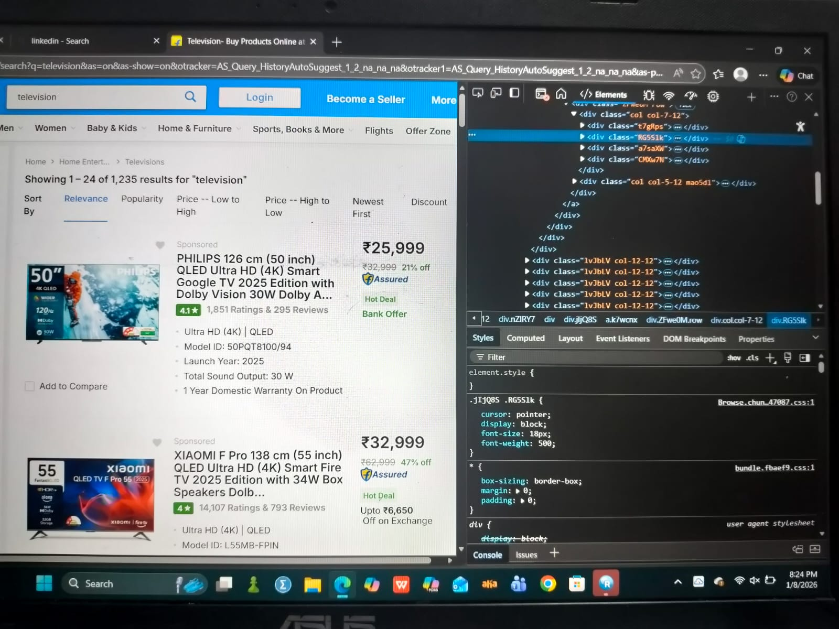
Web Scrapping
Flipkart was chosen as the primary data source for extracting television product information.
Browser developer tools (Inspect Element) were used to identify relevant HTML tags containing details such as television name, brand, price, screen size, resolution, and ratings.
Python libraries like Requests and BeautifulSoup were utilized to send HTTP requests and scrape television data from Flipkart web pages.
Multiple pages were accessed to gather a comprehensive set of television listings for better analysis.

Slide 8
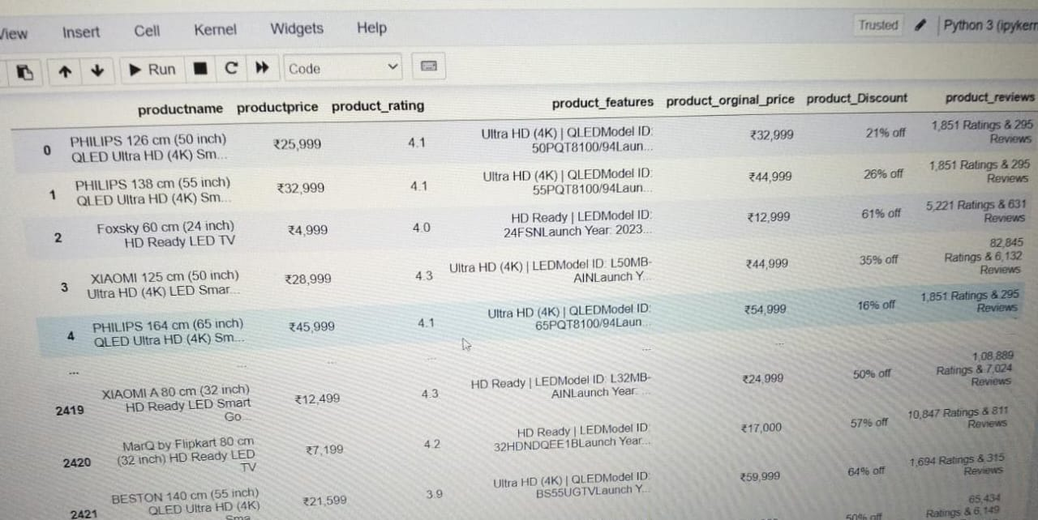
Dataset

Slide 9






Tools used

Slide 10
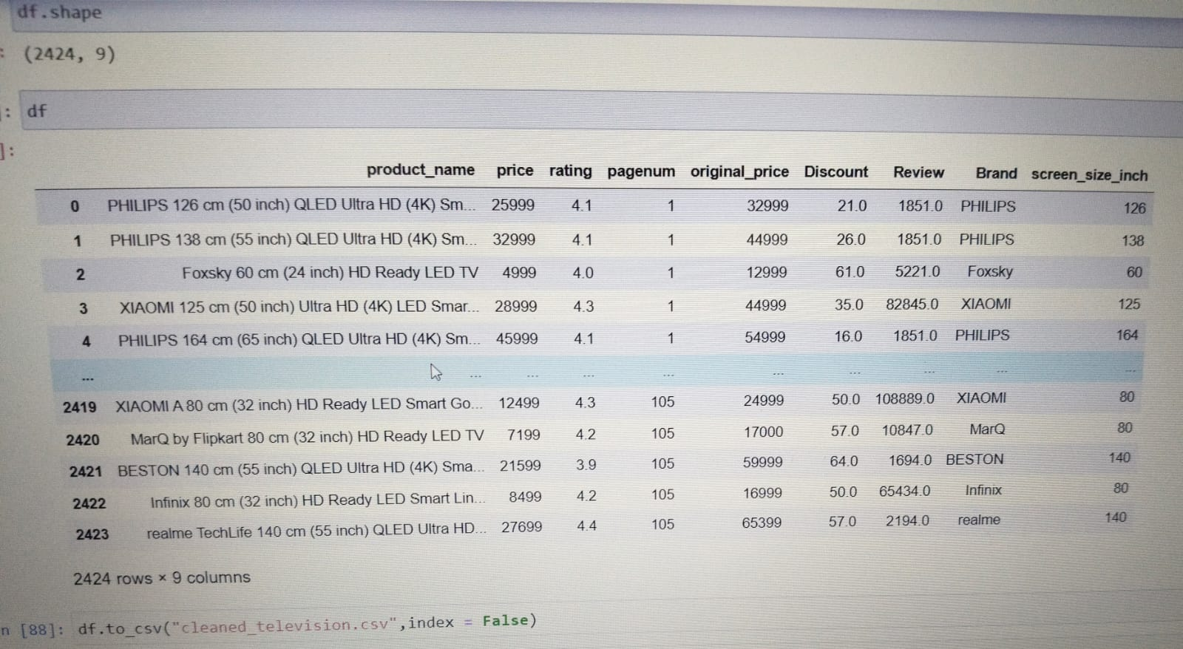
Data Cleaning Steps
Removed missing and duplicate records to ensure the dataset contained only unique and valid television entries.
Handled inconsistent data formats such as irregular price symbols (₹, commas) and rating formats (for example, “4.3★”).
Cleaned product names, screen size details, and specifications by removing unwanted characters and extra spaces for consistency.
Converted price columns into numeric format and ratings into float values to enable accurate calculations and visual analysis.
Filtered out irrelevant or incomplete television records that lacked essential details.
Exported the cleaned television dataset into a structured CSV or Excel file for further analysis and visualization using Python.

Slide 11
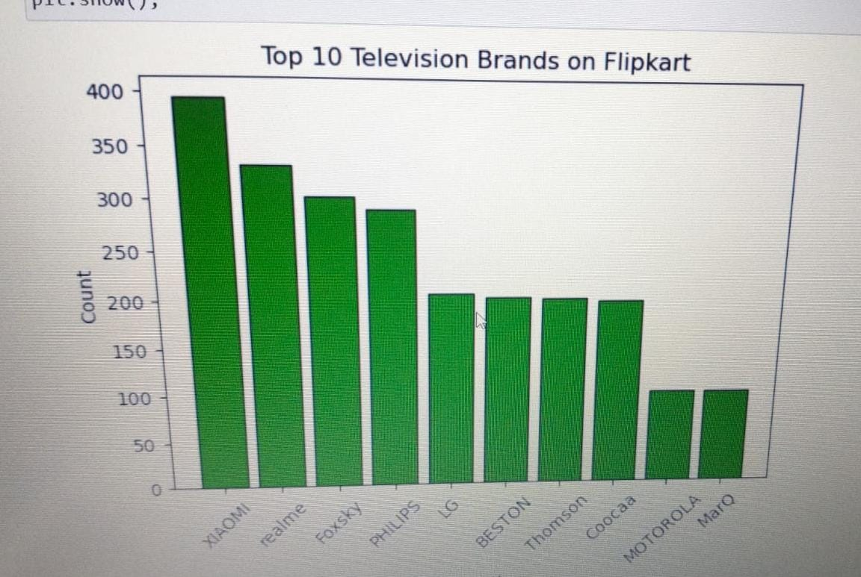
Data Visualization Univariate Analysis (Categorical)
Seaborn barplot() (or Matplotlib’s bar()) was used to analyze the distribution of the Brand categorical variable, highlighting the market presence of different manufacturers.
The bar chart displays the Top 10 Television Brands available on Flipkart, clearly showing that brands such as Samsung, LG, and Sony dominate the dataset with the highest number of television models.
The analysis reveals a sharp decline in model count after the top three brands, indicating that a majority of televisions are offered by a few leading manufacturers, while brands like Mi, OnePlus, and TCL appear with comparatively fewer models.
The x-axis labels are rotated for better readability, highlighting that the television market on Flipkart is highly concentrated among a small number of well-established brands, reflecting strong brand dominance and consumer preference.

Slide 12
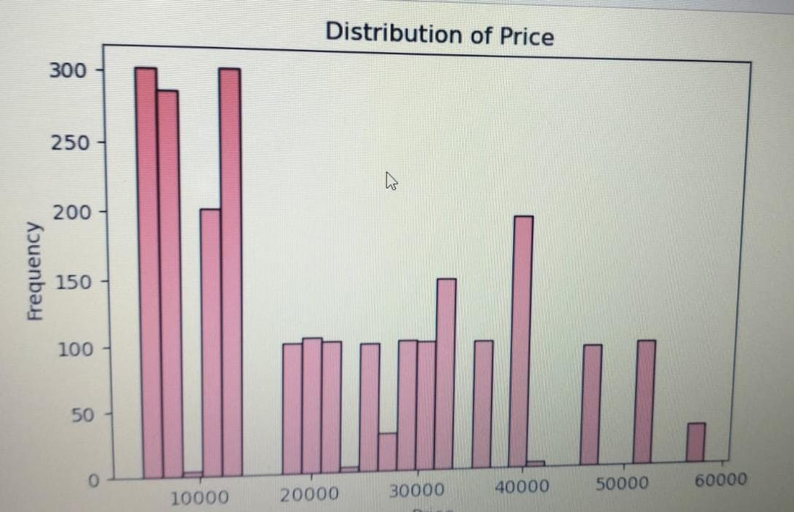
Data Visualization Univariate Analysis(Numerical)
A histogram was used to analyze the distribution of television prices on Flipkart, helping to identify the most common price segments available to customers.
Smaller clusters appear around the ₹25,000 and ₹40,000 price points, representing premium segments such as smart TVs with larger screen sizes, higher resolution (4K), and advanced features.
The visualization clearly highlights that Flipkart’s television inventory is primarily focused on budget-friendly and mid-range consumers, as the frequency of models drops significantly beyond the ₹20,000 range, showing fewer high-end offerings compared to affordable options.
.

Slide 13
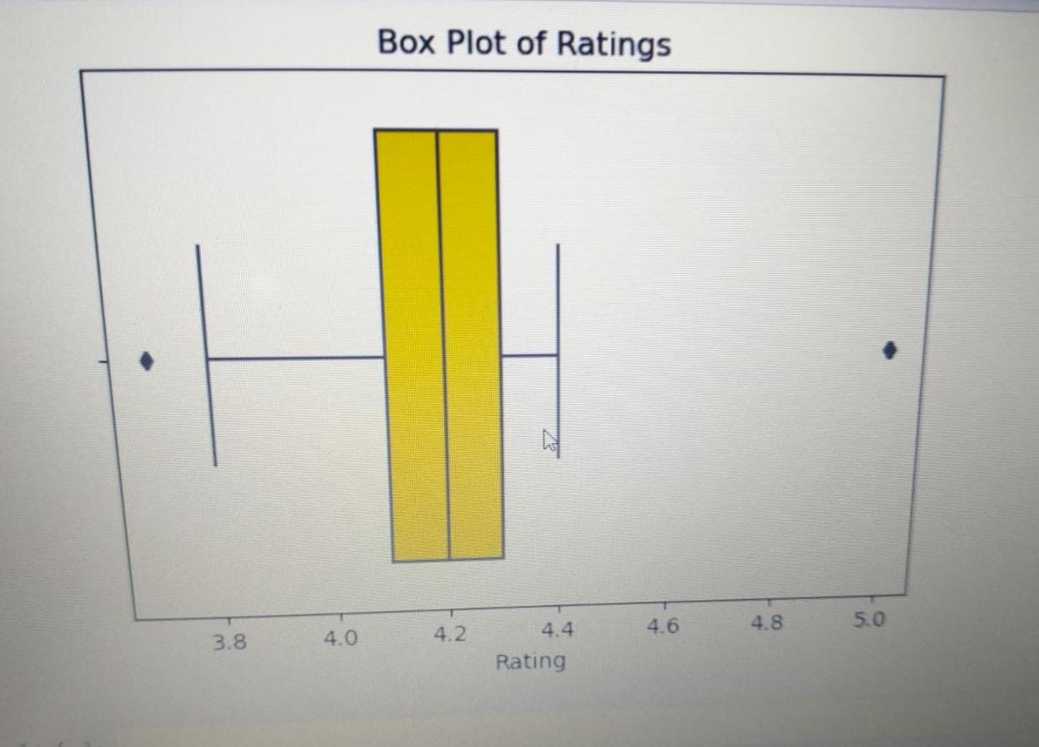
Data Visualization Bivariate Analysis(Categorial vs Numerical)
.
A box plot was created to compare the price distribution of televisions across the top 5 brands on Flipkart, highlighting differences in pricing strategies among manufacturers.
Samsung shows the widest price range and the highest-priced television models, indicating a premium positioning with both mid-range and high-end TVs. Its median price is noticeably higher than brands such as Mi or Realme.
Mi and Realme display narrow box plots, suggesting a consistent and budget-friendly pricing strategy where most television models fall within an affordable price range.
.

Slide 14
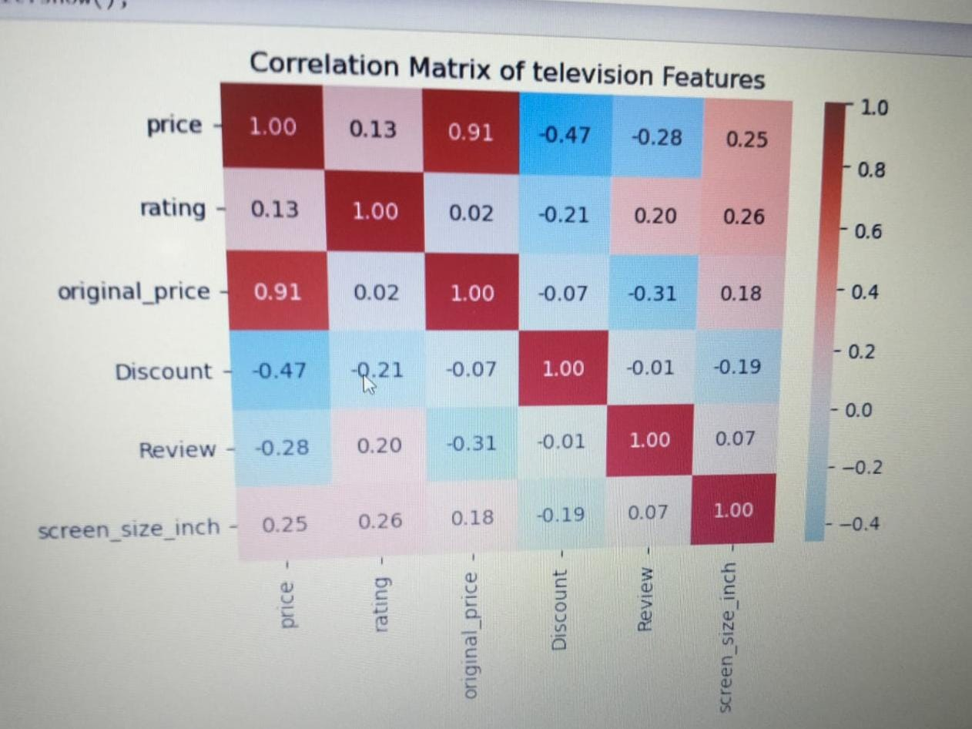
Data Visualization
Bivariate Analysis(Numerical vs Numerical)
In our Flipkart Television Web Scraping project, the heatmap is used only to visualize correlations between variables that were already computed from the scraped data; it does not calculate the correlations itself.
Price and screen size show a strong positive relationship. Larger televisions generally cost more, but the final price is also influenced by brand value, display technology (LED, QLED, OLED), and smart features.
Selling price and original (MRP) price are almost perfectly correlated and act as duplicate variables. Keeping both can cause multi collinearity issues, so retaining only one price column improves the quality of analysis.

Slide 15
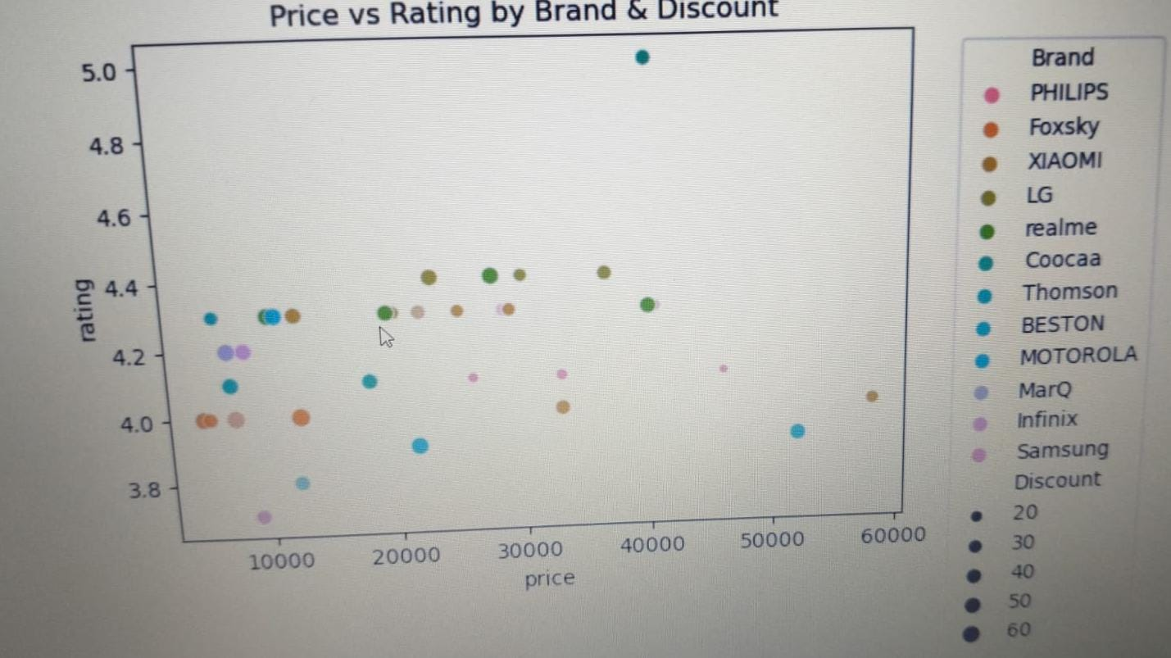
Data Visualization Multivariate Analysis
Television ratings on Flipkart are tightly clustered between 4.2 and 4.5, showing little to no correlation between price and customer satisfaction.
This indicates that higher-priced televisions do not automatically receive better ratings.
Premium brands such as Samsung and Sony do not consistently achieve higher ratings compared to mid-range brands, suggesting that consumers are often paying more for brand value, screen size, or advanced specifications, rather than a noticeable improvement in viewing satisfaction.

Slide 16
Conclusion
The analysis shows that television prices on Flipkart increase mainly due to screen size, technology (LED, QLED, 4K), and brand positioning, rather than customer ratings. Ratings remain closely clustered between 4.2 and 4.5 across almost all price ranges, indicating that higher-priced televisions do not deliver significantly better user satisfaction.
The selling price and original (MRP) price are largely redundant, and the observed discounts show a weak relationship with actual television features or performance. This suggests that discounts are primarily marketing strategies rather than indicators of product quality.
Overall, the Flipkart television market is highly competitive, with mid-range televisions dominating the catalog. Customer satisfaction appears consistent across different brands and price segments, implying that purchasing decisions should focus more on key features such as screen size, resolution, smart TV capabilities, and display technology, rather than being influenced by price levels or discount hype.

Slide 17


